Slide 1
Unit II-Cloud Enabling technology and Virtualization
Cloud-Enabling Technology: Broadband Networks and Internet Architecture, Data Center Technology, Virtualization Technology, Web Technology, Multitenant Technology, Service Technology.
Implementation Levels of Virtualization, Virtualization Structures/Tools and Mechanisms, Types of Hypervisors, Virtualization of CPU, Memory, and I/O Devices, Virtual Clusters and Resource Management, Virtualization for Data-Center Automation.

Slide 2
Agenda
Broadband Networks and Internet Architecture,
Data Center Technology,
Virtualization Technology,
Virtualization Structures/Tools and Mechanisms,
Types of Hypervisors,
Virtualization of CPU, Memory, and I/O Devices,
Virtual Clusters and Resource Management,
Virtualization for Data-Center Automation.

Slide 3
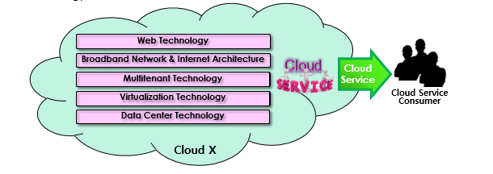
Cloud Enabling Technology
Integrated technology
Not something entirely new – combined of & integrated from a number of existing technologies
Integrating a number of existing core technologies into a single service – already matured and some of them more evolved on the way
Existing technologies enabled cloud computing include:
Broadband networks & internet architecture
Data center technology
Virtualization technology
Web technology
Multitenant technology
Service technology

Slide 4
Broadband Networks & Internet Architecture
Cloud service
Requires remotely accessible service by definition – network connections are inevitable
Implies inherent dependency on internet technology
Enables remote provisioning of IT resources via ubiquitous network access (VPN or public network)
Advances in accordance with the advancements of internet technology and QoS

Slide 5
Broadband Networks & Internet Architecture
Internet Service Providers (ISPs)
An organization providing national-wide or world-wide internet access service
Governed by Internet Corporations for Assigned Names and Numbers (ICANN)
No comprehensive governing by ICANN – ISPs freely deploys, operates and manages their own networks based on basically decentralized provisioning and management models
Fundamental governmental and regulatory laws applied within national borders
Internet topology – a dynamic and complex aggregate of ISPs highly interconnected via its core protocols
Worldwide connectivity via a hierarchical topology composed of Tier 1(large-scale international ISPs), Tier 2 (large regional ISPs) and Tier 3 (local ISPs)
Two fundamental components of internetworking architecture: connectionless packet switching vs. router-based interconnectivity

Slide 6
Broadband Networks & Internet Architecture
Connectionless packet switching (datagram network)
End-to-end (sender-receiver pair) data message divided into packets of limited size
Each packet processed through network switches and routers, queued and forwarded from one intermediary node to the next
Necessary transfer information carried by each packet in accordance with corresponding protocols such as Internet Protocol (IP) address or Media Access Control (MAC) address

Slide 7
Broadband Networks & Internet Architecture
Router-based interconnectivity
A router – a device connected to multiple networks through which it forwards packets
Each packet transferred (stored & forwarded at each router) to destination individually via possibly different routes from each other ⇨ routing information (IP addresses of the source & the destination, sequential number, etc.) included in each packet
Packets reassembled into a message on the destination node (at the network layer)
Each router responsible for finding the most efficient hop for packet delivery at runtime
Possibly multiple ISP networks between a cloud customer and its cloud provider
7 abstraction layer model defined in OSI (Open Systems Interconnection) project by ISO/IEC 7498-1
physical layer (1), data link layer (2), network layer (3), transport layer (4), session layer (5), presentation layer (6), application layer (7)

Slide 8
Broadband Networks & Internet Architecture
Layer | Protocol Data Unit (PDU) | Function
7. Application | Data | High-level APIs, including resource sharing, remote file access – HTTP, FTP etc.
6. Presentation |  | Translation of data between a networking service and an application; including character encoding, data compression and encryption/decryption
5. Session |  | Managing communication sessions, i.e. continuous exchange of information in the form of multiple back-and-forth transmissions between two nodes
4. Transport | Segment (TPC) / Datagram (UDP) | Reliable transmission of data segments between points on a network, including segmentation, acknowledgement and multiplexing
3. Network | Packet | Structuring and managing a multi-node network, including addressing, routing and traffic control
2. Data Link | Frame | Reliable transmission of data frames between two nodes connected by a physical layer
1. Physical | Bit | Transmission and reception of raw bit streams over a physical medium

Slide 9
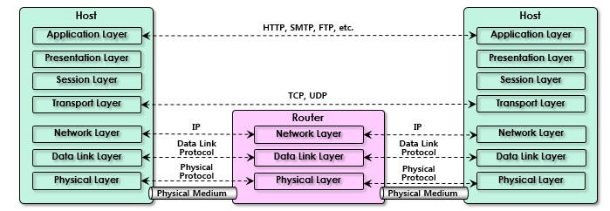
Broadband Networks & Internet Architecture

Slide 10
Broadband Networks & Internet Architecture
OSI 7 layer model
Physical layer (Layer 1)
Defines for the electrical and physical specifications of the data connection
Defines the relationship between a device and a physical transmission medium (e.g., a copper or fiber optical cable, radio frequency) including the layout of pins, voltages, line impedance, cable specifications, signal timing and similar characteristics for connected devices and frequency (5 GHz or 2.4 GHz etc.) for wireless devices
Responsible for transmission and reception of unstructured raw data in a physical medium
Defines the network topology as bus, mesh, or ring being some of the most common
Includes Parallel SCSI, Ethernet & other local-area networks such as token ring, FDDI, ITU-T G.hn, and IEEE 802.11 (Wi-Fi)
Defines personal area networks such as Bluetooth and IEEE 802.15.4 as well
Defines low-level networking equipment, such as network adapters, repeaters, network hubs, modems, and fiber media converters
Protocol independent - never concerned with protocols or other such higher-layer items

Slide 11
Broadband Networks & Internet Architecture
OSI 7 layer model
Data link layer (layer 2)
Provides node-to-node data transfer – a link between two directly connected nodes
Detects and possibly corrects errors that may occur in the physical layer
Defines the protocol to establish and terminate a connection between two physically connected devices as well as the protocol for flow control between them
High-speed local area networking over existing wires (power lines, phone lines and coaxial cables) defined by The ITU-T G.hn standard in this data link layer, providing both error correction and flow control by means of a selective-repeat sliding-window protocol

Slide 12
Broadband Networks & Internet Architecture
OSI 7 layer model
Data link layer (layer 2)
Provides node-to-node data transfer – a link between two directly connected nodes
Detects and possibly corrects errors that may occur in the physical layer
Defines the protocol to establish and terminate a connection between two physically connected devices as well as the protocol for flow control between them
High-speed local area networking over existing wires (power lines, phone lines and coaxial cables) defined by The ITU-T G.hn standard in this data link layer, providing both error correction and flow control by means of a selective-repeat sliding-window protocol
Divided into two sublayers by IEEE 802:
Media Access Control (MAC) layer - responsible for controlling how devices in a network gain access to medium and permission to transmit it
Logical Link Control (LLC) layer - responsible for identifying Network layer protocols and then encapsulating them and controls error checking and frame synchronization
Includes the MAC and LLC layers of IEEE 802 networks such as 802.3 Ethernet, 802.11 Wi-Fi, and 802.15.4 ZigBee
Defines the Point-to-Point Protocol (PPP) that can operate over several different physical layers, such as synchronous and asynchronous serial lines

Slide 13
Broadband Networks & Internet Architecture
OSI 7 layer model
Network layer (Layer 3)
Provides the functional and procedural means of transferring variable length data sequences (called datagrams) from one node to another connected to the same "network"
A network – a communication medium to which many nodes with addresses (e.g., IP) can be connected, allowing each member node to transfer a message to any other member nodes via address resolution or routing through intermediate nodes
Large messages divided into several fragments before sending and reassembled again upon receiving at the network layer
May report delivery errors – message delivery at the network layer is not necessarily guaranteed to be reliable; a network layer protocol may provide reliable message delivery, but it need not do so.
Defines a number of layer-management protocols (a function defined in the management annex, ISO 7498/4) including routing protocols, multicast group management, network-layer information and error, and network-layer address assignment – determined by the payload that makes these belong to the network layer, not the protocol that carries them

Slide 14
Broadband Networks & Internet Architecture
OSI 7 layer model
Transport layer (Layer 4)
Provides the functional and procedural means of transferring variable-length data sequences from a source to a destination host via one or more networks, while maintaining the quality of service functions - Transmission Control Protocol (TCP) usually built on top of the Internet Protocol (IP) is an example of a transport-layer protocol in the standard Internet stack
Controls the reliability of a given link through flow control, segmentation/desegmentation, and error control
Some protocols are state- and connection-oriented implying that the transport layer can keep track of the segments and re-transmit those that fail.
Also provides the acknowledgement of the successful data transmission and sends the next data if no errors occurred
Creates packets out of the message received from the application layer. Packetizing is a process of dividing the long message into smaller messages.
Five classes of connection-mode transport protocols defined by OSI, ranging from class 0 (which is also known as TP0 and provides the fewest features) to class 4 (TP4, designed for less reliable networks, similar to the Internet)
Class 0: contains no error recovery and designed for use on network layers that provide error-free connections
Class 4: closest to TCP, although TCP contains functions, such as the graceful close, which OSI assigns to the session layer
All OSI TP connection-mode protocol classes provide expedited data and preservation of record boundaries.
Similar to a post office which deals with the dispatch and classification of mail and parcels sent

Slide 15
Broadband Networks & Internet Architecture
OSI 7 layer model
Packets are then encapsulated into higher level protocols, such as cryptographic presentation services that can be read by the addressee only.
Non-IP tunneling protocols operating at the transport layer: IBM's SNA, Novell's IPX over an IP network, or end-to-end encryption with IPsec
While Generic Routing Encapsulation (GRE) might seem to be a network-layer protocol, if the encapsulation of the payload takes place only at endpoint, GRE becomes closer to a transport protocol that uses IP headers but contains complete frames or packets to deliver to an endpoint.
L2TP carries PPP frames inside transport packet.
Although not developed under the OSI Reference Model and not strictly conforming to the OSI definition of the transport layer, the Transmission Control Protocol (TCP) and the User Datagram Protocol (UDP) of the Internet Protocol Suite are commonly categorized as layer-4 protocols within OSI.

Slide 16
Broadband Networks & Internet Architecture
Feature Name | TP0 | TP1 | TP2 | TP3 | TP4
Connection-oriented Network | Yes | Yes | Yes | Yes | Yes
Connectionless Network | No | No | No | No | Yes
Concatenation and Separation | No | Yes | Yes | Yes | Yes
Segmentation and Reassembly | Yes | Yes | Yes | Yes | Yes
Error Recovery | No | Yes | Yes | Yes | Yes
Reinitiate Connection* | No | Yes | No | Yes | No
Multiplexing / Demultiplexing over Single Virtual Circuit | No | No | Yes | Yes | Yes
Explicit Flow Control | No | No | Yes | Yes | Yes
Retransmission on Timeout | No | No | No | No | Yes
Reliable Transport Service | No | Yes | No | Yes | Yes
* If an excessive number of PDUs are unacknowledged

Slide 17
Broadband Networks & Internet Architecture
OSI 7 layer model
Session layer (Layer 5)
Controls the dialogues (connections) between computers - establishing, managing and terminating the connections between the local and remote application
Provides for full-duplex, half-duplex, or simplex operation, and establishes checkpointing, adjournment, termination, and restart procedures
Also provides graceful close of sessions which is a property of the Transmission Control Protocol and session checkpointing and recovery which is not usually used in the Internet Protocol Suite
Commonly implemented explicitly in application environments that use remote procedure calls

Slide 18
Broadband Networks & Internet Architecture
OSI 7 layer model
Presentation layer (Layer 6)
Establishes context between application-layer entities, in which the application-layer entities may use different syntax and semantics if the presentation service provides a mapping between them
Encapsulates presentation service data units into session protocol data units that are then passed down the protocol stack If a mapping is available
Provides independence from data representation (e.g., encryption) by translating between application and network formats
Transforms data into the form that the application accepts - formatting and encrypting data to be sent across a network (sometimes called the syntax layer)
The original presentation structure used the Basic Encoding Rules of Abstract Syntax Notation One (ASN.1) with capabilities such as converting an EBCDIC-coded text file to an ASCII-coded file, or serialization of objects and other data structures from and to XML.

Slide 19
Broadband Networks & Internet Architecture
OSI 7 layer model
Application layer (Layer 7)
The OSI layer closest to the end user which means both the OSI application layer and the user interact directly with the software application
Interacts with software applications (outside the scope of the OSI model) that implement a communicating component
Includes functions such as identifying communication partners, determining resource availability, and synchronizing communication
Determines the identity and availability of communication partners for an application with data to transmit when identifying communication partners
Must decide whether sufficient network resources for the requested communication are available when determining resource availability

Slide 20
Broadband Networks & Internet Architecture
Technical and business considerations
Connectivity issues
Traditional deployment model
Via the corporate network (VPN) which provide uninterrupted Internet connectivity
Completely controlled by the organizations with their own safeguard based on firewalls and various monitoring tools
Each organization responsible for deploying, operating and managing their IT resources and Internet connectivity
Cloud deployment model
Continuous access to centralized servers and applications granted to end-user devices as long as they are connected to the network through the Internet in the cloud
Centralized IT resources accessible using the same network protocols regardless of whether users reside inside or outside of a corporate network
Cloud IT resources configured by cloud providers to be accessible for both external and internal users through an Internet connection and for cloud consumers to provide Internet-based services to external users

Slide 21
Broadband Networks & Internet Architecture
On-premise IT Resources | Cloud-based IT Resources
Internal end-user devices access corporate IT services through the corporate network. | Internal end-user devices access corporate IT services through an Internet connection.
Internal users access corporate IT services through the corporate Internet connection while roaming in external networks. | Internal users access corporate IT services while roaming in external networks through the cloud provider’s Internet connection.
External users access corporate IT services through the corporate Internet connection. | External users access corporate IT services through the cloud provider’s Internet connection.

Slide 22
Broadband Networks & Internet Architecture
Network bandwidth and latency issues
Network QoS: bandwidth, latency, jitter
Bandwidth – how much data can be transferred within a unit time
End-to-end bandwidth determined by the transmission capacity of the shared data links that connect intermediary nodes
Attempt to improve end-to-end bandwidth by ISPs with technologies such as broadband network technology & web acceleration technologies – dynamic caching, compression, pre-fetching, etc.
Critical for applications requiring substantial amount of data transfer

Slide 23
Broadband Networks & Internet Architecture
Network bandwidth and latency issues
Latency – how fast a request can be satisfied (time for a packet to travel from one node to another)
The longer a packet travels the larger the latency is – web caching technology can apply
The more network traffic is the larger the latency is – more queuing delay at each hop
Critical for applications with a business requirement of fast response time

Slide 24
Broadband Networks & Internet Architecture
Network bandwidth and latency issues
Jitter – how consistent the given latency is
A gap between the smallest latency and the largest latency
Response time less than a millisecond in general, but frequently more than several seconds
Internet-wide QoS control required to guarantee small jitter
QoS of the underlying network inherited to QoS of the given cloud service

Slide 25
Broadband Networks & Internet Architecture
Network bandwidth and latency issues
Cloud carrier and cloud provider selection
Involves multiple cloud carriers to achieve the necessary level of connectivity and reliability for the given cloud applications resulting in additional costs
QoS determined by multiple ISPs involved & required collaboration of the cloud carriers
Wise to adopt more relaxed latency and bandwidth requirements

Slide 26
Data Center Technology
Data center
Grouping IT resources in close proximity with one another (rather than having them geographically dispersed) for power sharing, higher efficiency in shared IT resource usage and improved accessibility for IT personnel – reason for popularizing data center concept
Characterized for centralized IT resources such as servers, storages, databases, networking & telecommunication devices and software solutions via applying a number of technologies

Slide 27
Data Center Technology
Standardization and modularity
Built upon standardized commodity hardware and designed with modular architecture
Aggregating multiple identical building blocks of facility infrastructure and equipment to support scalability, growth and speedy hardware replacements
Reduces investment and operational costs as they enable economies of scale for the procurement, acquisition, deployment, operation and maintenance processes
IT resource consolidation favored by common virtualization strategies and the constantly improving capacity and performance of physical devices

Slide 28
Data Center Technology
Virtualization
Virtualization: an abstraction layer with mapping or redirection capability
Physical IT resources: the facility infrastructure that houses computing/networking systems and equipment, together with hardware systems and their operating systems
Virtual IT resources: comprised of operational and management tools that are often based on virtualization platforms that abstract the physical computing and networking IT resources as virtualized components that are easier to allocate, operate, release, monitor and control (more details later)
Automation
Reduces operational costs and the error rate in data center via automated management without human supervision – provisioning, configuration, patching and monitoring
Enables self-configuration and self-recovery – basis of automatic computing technology

Slide 29
Data Center Technology
Remote operation and management
Most operational and administrative tasks of IT resources in data center can be commanded through the network’s remote (within data center boundary in general) consoles and management systems.
Most operational and administrative tasks carried out from the control room in data center except for those requiring physical operations such as hardware jobs or cabling
Remote operation from outside of data center boundary strictly prohibited in general.

Slide 30
Data Center Technology
High availability
All resources in data center are subject to fail anytime based on current hardware and software technologies.
Most resource failures affect service continuity and underlying business as well.
In general, data center provides fail-safe technologies mainly based on redundancy in every possible layer – fault-tolerant or fault-resilient technologies on top of redundant resources: power supply, cabling, networking, servers, storages and software licenses.
Fault-avoidance technologies: load balancing, scaling-up/down, etc.

Slide 31
Data Center Technology
Security-aware design, operation and management
The level of security determines the credibility of the given data center.
Security issue is the main concern that prohibits many organizations from migrating their IT resources from on-premise to cloud-based.
Security threats that make organizations hesitate to outsource IT environment are two-fold: possible malicious attack from outside and anxiety about keeping data outside of organization’s physical boundary (not only business-wise but also legality-wise).
Various levels of protection and security mechanisms: network isolation, firewalls and monitoring tools – big data analysis recently

Slide 32
Data Center Technology
Facilities
Typically custom-designed computing resources, storages and network equipment for the given purpose
Several functional layout areas based on power supplies, cabling, environmental control stations that regulate heating, ventilation, air conditioning, fire protection, (physical) security & access control system, monitoring system, etc.

Slide 33
Data Center Technology
Computing hardware
Mainly composed of standardized commodity servers with a number of computing hardware technologies such as:
Rack technology – standardized rack with interconnects for power, network, and internal cooling
CPU architecture – support for various CPU types: x86-32bits, x86-64bits, RISC, CISC, etc.
Multi-core CPU architecture – hundreds of physical & logical processing core in single unit of standardized racks
Redundancy & hot-swap technology – hard disks, power supplies, network interfaces, storage controller cards, etc.

Slide 34
Data Center Technology
Computing hardware
Blade server technologies with rack-embedded physical interconnections (blade enclosures), fabrics (switches), power supply units, cooling fans, etc.
Maximizes and enhances inter-component networking and management while optimizing physical space & power via individual server hot-swapping, scaling, replacement and maintenance
Benefits the deployment of fault-resilient (tolerant) systems based on cluster technology
Several industry-standard and proprietary operational and management software tools that configure, monitor, and control hardware IT resources from remote & centralized consoles – self-provisioning
Hundreds or even thousands of physical or virtual servers (IT resources) operated by a single operator

Slide 35
Data Center Technology
Storage hardware
Needs to deal with tons of data created every day – easily reaching PBs of total scale in general
One of the most difficult task to deal with in data center and many different levels of technologies for fast access, data availability, massive data accommodation, etc.:
RAID (Redundant Array of Independent/Inexpensive Disks) – integrating hundreds of individual HDD to provide fast, reliable, massive storage space
IO caching – at different layers: storage controllers, each physical/virtual servers, separate caching servers
Hot-swapping – replacing faulty HDD without requiring prior power down (a part of RAID technology)
Storage virtualization – abstracted storage layer creating virtual storage device free from the physical property of member storage devices
Data replication – memory snapshot, volume cloning, mirroring, DR, CDP, etc.
Distributed storage – file, block, object-level distributed storage: HDFS, Ceph, etc.

Slide 36
Data Center Technology
Storage Topology
DAS (Direct Attached Storage): storages directly attached to a host system via block-level channel protocol such as SCSI/FC
NAS (Network Attached Storage): storages attached to a number of host systems via file-level network protocols such as NFS/CIFS/SMB – while providing file-level data sharing among multiple hosts
SAN (Storage Area Network): storages attached to multiple hosts via block-level network protocols such as Fibre Channel, Infiniband, iSCSI, etc.
Data backup issues in data center

Slide 37
Data Center Technology
Network hardware
One of the most important IT capabilities for data center to support remote IT access – broken down into five network subsystems in general
Carrier & external network interconnection ⇨ internetworking infrastructure comprised o backbone routers that provide routing between external WAN connections and LANs in the given data center including firewalls and VPN gateways
Web-tier load balancing and acceleration ⇨ for even distribution of web traffics and acceleration of web protocols comprised of XML pre-processors, encryption/decryption appliances (web acceleration), layer 7 switching devices (content-aware load balancing), etc.
LAN fabric ⇨ intranetworking infrastructure comprised of multiple layer 4 or lower switching devices up to ~10G bandwidth providing several virtualization functions such as LAN segregation into VLANs, link aggregation, control routing between networks, load balancing, failover (redundant connectivity), etc.
SAN fabric ⇨ data networking infrastructure composed of multiple SAN switching devices based on data networking protocols such as Fibre Channel (FC), Fibre Channel over Ethernet (FCoE), Infiniband (IB), Internet Small Computer Systems Interface (iSCSI)
NAS gateway ⇨ shared file-transfer networking infrastructure composed of a number of NAS-based storage devices based on file-transfer protocols such as NFS and SMB/CIFS (Samba)

Slide 38
Data Center Technology
Basically redundant and/or fault-tolerant networking configurations for scalability and high availability
DWDM (Dense Wavelength Driven Multiplexing) devices for ultra high-speed networking and improved resiliency ⇨ in general for the purpose of high-speed real-time data replication between data centers
Other consideration
Technological obsolescence, heterogeneity, security, vast quantities of data and their backup, etc.

Slide 39
Virtualization Technology
Virtualization is a technique of how to separate a service from the underlying physical delivery of that service. It is the process of creating a virtual version of something like computer hardware.
It involves using specialized software to create a virtual or software-created version of a computing resource rather than the actual version of the same resource.
With the help of Virtualization, multiple operating systems and applications can run on same machine and its same hardware at the same time, increasing the utilization and flexibility of hardware.

Slide 40
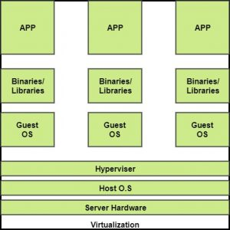
Virtualization Technology
The machine on which the virtual machine is going to be built is known as Host Machine and that virtual machine is referred as a Guest Machine.

Slide 41
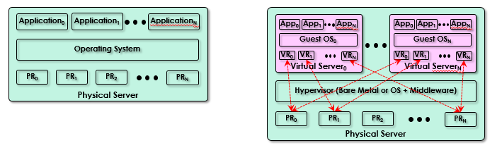
Virtualization Technology

Slide 42
Benefits of Virtualization
More flexible and efficient allocation of resources.
Enhance development productivity.
It lowers the cost of IT infrastructure.
Remote access and rapid scalability.
High availability and disaster recovery.
Pay peruse of the IT infrastructure on demand.
Enables running multiple operating systems.

Slide 43
Types of Virtualization
Application Virtualization.
Network Virtualization.
Desktop Virtualization.
Storage Virtualization.
Server Virtualization.
Data virtualization.

Slide 44
Application Virtualization
Application virtualization helps a user to have remote access of an application from a server. The server stores all personal information and other characteristics of the application but can still run on a local workstation through the internet.
Example of this would be a user who needs to run two different versions of the same software. Technologies that use application virtualization are hosted applications and packaged applications.

Slide 45
Network Virtualization
The ability to run multiple virtual networks with each has a separate control and data plan. It co-exists together on top of one physical network. It can be managed by individual parties that potentially confidential to each other.
Network virtualization provides a facility to create and provision virtual networks—logical switches, routers, firewalls, load balancer, Virtual Private Network (VPN), and workload security within days or even in weeks.

Slide 46
Desktop Virtualization
Desktop virtualization allows the users’ OS to be remotely stored on a server in the data centre. It allows the user to access their desktop virtually, from any location by a different machine.
Users who want specific operating systems other than Windows Server will need to have a virtual desktop. Main benefits of desktop virtualization are user mobility, portability, easy management of software installation, updates, and patches.

Slide 47
Storage Virtualization
Storage virtualization is an array of servers that are managed by a virtual storage system.
The servers aren’t aware of exactly where their data is stored, and instead function more like worker bees in a hive. It makes managing storage from multiple sources to be managed and utilized as a single repository.

Slide 48
Server Virtualization
This is a kind of virtualization in which masking of server resources takes place. Here, the central-server(physical server) is divided into multiple different virtual servers by changing the identity number, processors.
So, each system can operate its own operating systems in isolate manner. Where each sub-server knows the identity of the central server. It causes an increase in the performance and reduces the operating cost by the deployment of main server resources into a sub-server resource.

Slide 49
Data Virtualization
This is the kind of virtualization in which the data is collected from various sources and managed that at a single place
And without knowing more about the technical information like how data is collected, stored & formatted then arranged that data logically so that its virtual view can be accessed by its interested people and stakeholders, and users through the various cloud services remotely.

Slide 50
Virtualization Technology
Hardware independence
Creating standardized soft (virtual) copies of physical IT resources ⇨ eliminating hardware dependency
Easy automated VM migration or failover between different physical servers
Server consolidation
Creating different multiple virtual servers on a single physical server
Mainly for Increasing server utilization, load balancing or optimizing IT resource utilization
Support for common cloud features such as on-demand usage, resource pooling, elasticity, scalability and resiliency

Slide 51
Virtualization Technology
Resource replication
Virtual servers are implemented as virtual disk images (configuration, memory state, etc.) containing binary file copies of hard disk content and being accessible via simple file operations such as copy and move host OS.
Easy to be replicated, migrated, backed up and manipulated enabling:
Easy creation of standardized VM images with guest OS and pre-packaged application software in virtual disk images for instantaneous deployment
Increased agility in the migration and deployment of a virtual machine’s new instance by being able to rapidly scale out and up
Ability to roll back for instantaneous creation of VM snapshot by saving the state of the virtual server’s memory and hard disk image to a host-based file
Easy implementation of business continuity with efficient backup and restoration

Slide 52
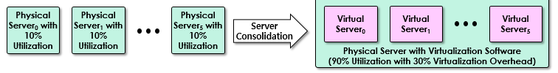
Virtualization Technology

Slide 53
Virtualization Technology
Operating system-based virtualization
Install virtualization software in a pre-existing operating system (host vs. guest)
Act as an application or more precisely as a middleware
Easy to deal with hardware compatibility issues even with absence of a specific hardware driver
Host OS services to be utilized: backup/recovery, integration to directory service, security management
Performance degradation due to:IT resource (CPU, Memory, etc.) sharing with host and guest OSs
Several additional traverse for each system call
Additional license cost for host OS (Windows license or Linux subscription)

Slide 54
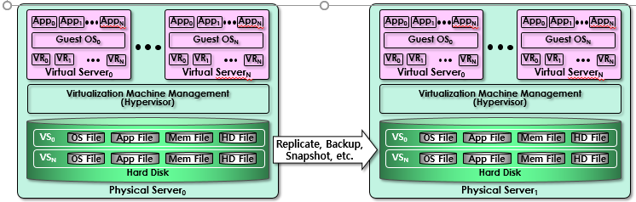
Virtualization Technology

Slide 55
Virtualization Technology
Virtualization management
Easier to administrate virtual servers than physical servers
Many administration tasks automated by virtualization software
VIM (Virtualization Infrastructure Management) tools – collectively manage virtual IT resources from a centralized & dedicated management computer (controller)

Slide 56
Virtualization Technology
Other consideration
Performance overhead
Not ideal for complex systems with heavy workload
Excessive or unnecessary performance overhead with poorly formulated virtualization plan
Para-virtualization APIs – modified to reduce the guest OS’s processing overhead ⇨ need to customize guest OSs to adapt them at the cost of sacrificing portability
Special hardware compatibility
There are many vendors supplying specialized hardware devices and not all of them are compatible with the given virtualization software.
Old and existing software may not support those hardware recently released.
Solution: standardization, commoditization and frequent virtualization software update/upgrade
Portability
Poor portability due to automated & programmatic VS management interfaces for their own
Demand for international standard such as OVF (Open Virtualization Format) for standardization of virtual disk formats in order to insure a wide range of VS management portability

Slide 57
Multitenant Technology
Multitenancy is a type of software architecture where a single software instance can serve multiple distinct user groups.
It means that multiple customer’s of cloud vendor are using same computing resources .
As they are sharing same computing resources but the data of each Cloud customer is kept totally separate and secure. It is very important concept of Cloud Computing.
In cloud computing Multitenancy also refer as shared host where same resources are divided among different customer’s.

Slide 58
Multitenant Technology
The multitenant application design was created to enable multiple users (tenants) to access the same application logic simultaneously.
Each tenant has its own view of the application that it uses, administers, and customizes as a dedicated instance of the software while remaining unaware of other tenants that are using the same application.

Slide 59
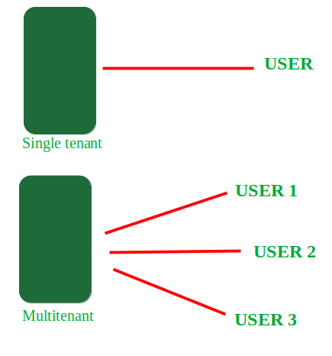
Multitenant Technology

Slide 60
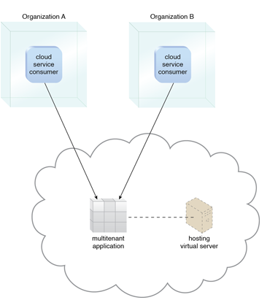
Multitenant Application

Slide 61
Advantages of Multitenant Technology
Use of Available resources is maximized by sharing resources.
Customer’s Cost of Physical Hardware System is reduces.
It reduce usage of physical devices and thus power consumption and cooling cost save.
Save Vendor’s cost as it become difficult for cloud vendor to provide separate Physical Services to each individual.

Slide 62
Disadvantages of Multitenant Technology
As data is stored in third party services , this reduces security of our data and put it into vulnerable condition .
Unauthorized access will cause damage of data.

Slide 63
Need of virtualization/Advantages of Virtualization
Resource Optimization
Consolidation
Automatically Protect Application from Server Failure
Easily Migrate Workloads as Needs Change
Save Resources and Money
Simplified management of data Center
Increased IT Productivity and Efficiency
Easy Disaster recovery
Enhanced Security

Slide 64
Disadvantages of Virtualization
It can be Expensive
Might not be compatible with other server and application
Needs training to network administrators
It still has limitations
Creates Security risk
Creates resource availability issue
Creates Scalability issue
Requires several links in a chain that must work together cohesively

Slide 65
Implementation Levels of Virtualization
Traditional computer runs under the control of its operating system which basically tailored for its hardware architecture
After the implementation of virtualization, various user application which are handled by their own operating system can be executed on the same hardware, independent of the host OS
This is usually implemented by introducing additional software called a virtualization layer or Hypervisor
The improtant funcationality of the software layer in the process of virtualization is to virtualize the physical hardware owned by the host machine in the form of virtual resource to be utilized by the VMs

Slide 66
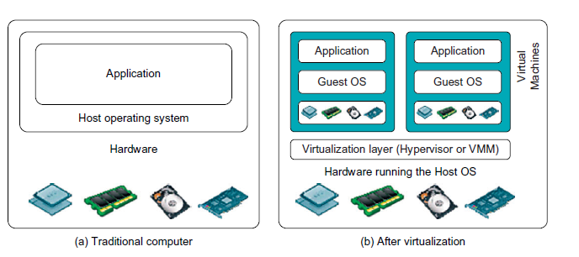
Implementation Levels of Virtualization

Slide 67
Implementation Levels of Virtualization
Functionality of software layer is implemented at different operational levels
The virtualization layer includes following levels:
Instruction Set Architecture(ISA) level
Hardware level
Operating System Level
Library Support Level
Application Level

Slide 68
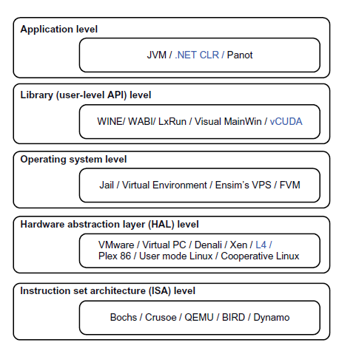
Implementation Levels of Virtualization

Slide 69
Virtualization at ISA (Instruction Set Architecture) level
Emulating a given ISA by the ISA of the host machine.
e.g, MIPS binary code can run on an x-86-based host machine with the help of ISA emulation.
Typical systems: Bochs, Crusoe, Quemu, BIRD, Dynamo
Advantage:
It can run a large amount of legacy binary codes written for various processors on any given new hardware host machines
best application flexibility
Shortcoming & limitation:
One source instruction may require tens or hundreds of native target instructions to perform its function, which is relatively slow.
V-ISA requires adding a processor-specific software translation layer in the complier.

Slide 70
Virtualization at Abstraction Level
Virtualization at Hardware Abstraction level:
Virtualization is performed right on top of the hardware.
It generates virtual hardware environments for VMs, and manages the underlying hardware through virtualization.
Typical systems: VMware, Virtual PC, Denali, Xen
Advantage:
Has higher performance and good application isolation
Shortcoming & limitation:
Very expensive to implement (complexity)

Slide 71
Virtualization at OS Level
It is an abstraction layer between traditional OS and user placations.
This virtualization creates isolated containers on a single physical server and the OS-instance to utilize the hardware and software in datacenters.
Typical systems: Jail / Virtual Environment / Ensim's VPS / FVM
Advantage:
Has minimal startup/shutdown cost, low resource requirement, and high scalability; synchronize VM and host state changes.
Shortcoming & limitation:
All VMs at the operating system level must have the same kind of guest OS
Poor application flexibility and isolation.

Slide 72
Virtualization at OS Level

Slide 73
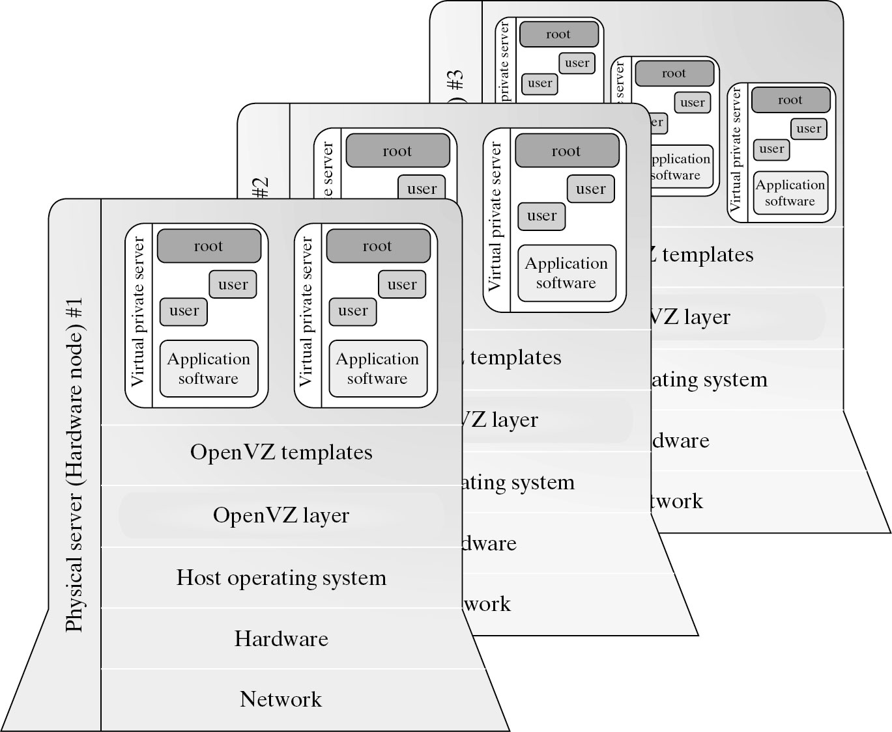
Virtualization for Linux

Slide 74
Virtualization at Library Support Level
It creates execution environments for running alien programs on a platform rather than creating VM to run the entire operating system.
It is done by API call interception and remapping.
Typical systems: Wine, WAB, LxRun , VisualMainWin
Advantage:
It has very low implementation effort
Shortcoming & limitation:
poor application flexibility and isolation

Slide 75
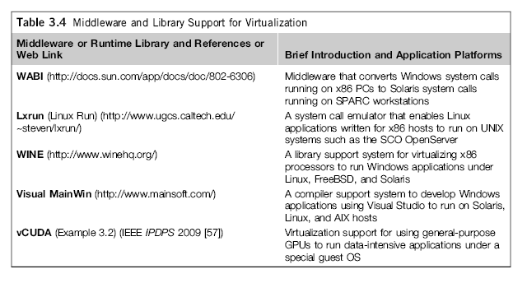
Virtualization with Middleware Support

Slide 76
The vCUBE for Virtualization of GPGPU

Slide 77
Virtualization at User Application Level
It virtualizes an application as a virtual machine.
This layer sits as an application program on top of an operating system and exports an abstraction of a VM that can run programs written and compiled to a particular abstract machine definition.
Typical systems: JVM , NET CLI , Panot
Advantage:
has the best application isolation
Shortcoming & limitation:
low performance, low application flexibility and high implementation complexity.

Slide 78
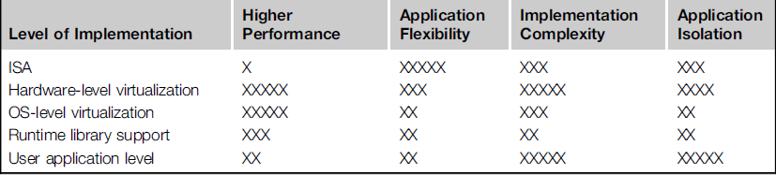
Relative Merits of Different Approaches
The column heading corresponds to four technical heading
- Higher Performance
- Application Flexibility
- Implementation Complexity[implies the implementation cost of virtualization level]
- Application Isolation[refers to the effort required to isolate resource committed to different VMs]

Slide 79
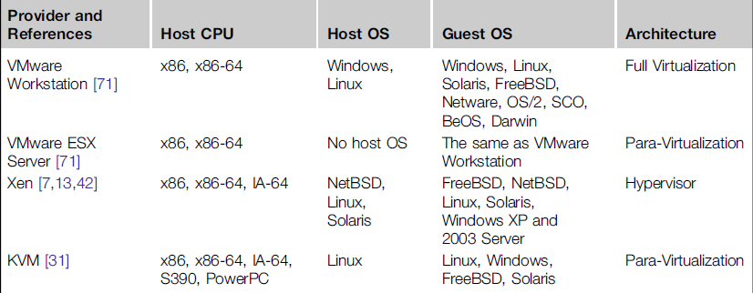
VMM Design Requirements and Providers
Hardware-level virtualization insert a layer between real hardware and
traditional Operating systems call as Virtual Machine Monitor(VMM)
It manages hardware resources of a computing system
There are three requirements for VMM
- VMM should provide an environment for program which is
essentially Identical to original machine
- Program run in this environment should show, at worst, only
minor decrease in speed
- VMM should be in complete control of system resources

Slide 80
Virtualization Structure/Tools and Mechanisms
Before the implementation of virtualization, the hardware is managed by operating system
After virtualization process, a virtualization layer is placed in between the hardware and the OS
Converting the real hardware into virtual hardware is the responsibility of this virtualization layer
There are several classes of VM architecture which depends on the position of the virtualization layer. These are mainly Hypervisor architecture, Para Virtualization, Full virtualization

Slide 81
Hypervisor and Xen Architecture
Hypervisor is a type of hardware level virtualization
The hypervisor software is exactly paced between physical
hardware and its operating system
Hyper calls are provided by the hypervisor for the guest OS and application
It is very important that the hypervisor should have capability to convert physical devices into virtual resources

Slide 82
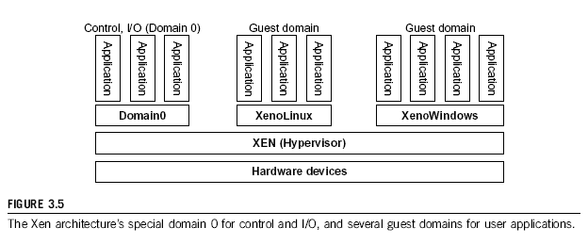
Xen Architecture
It is an open source hypervisor program which is developed by Cambridge University
All the machine are implemented by Xen hypervisor, and policy handling is the responsibility of Domain 0

Slide 83
In Xen, no device drivers are included natively, just a mechanism is provided by Xen with the help of which guest OS can have direct access to the physical device
Like other virtualization, number of guest OS can be executed on top of hypervisor
The guest OS, which can control other OS is known as Domain 0 while other are known as Domain U
Domain 0 is considered as privilege guest OS of Xen
Initially Domain 0 is loaded when Xen boots
The basic aim behind design of Domain 0 is to access hardware directly as well as manage device
Allocating and mapping hardware resources for the guest domain (Domain U) is responsibility of Domain 0

Slide 84
Full Virtualization
Hardware virtualization can be classified into two categories based on the implementation technology:
Full Virtualization and Host-based virtualization
Full Virtualization:
- Does not need to modify guest OS
- Non-critical instructions execute on hardware directly
- Critical instruction are trapped into VMM for binary
translation
- VMware Workstation applies full virtualization, which uses
binary translation to automatically modify x86 software on-
the-fly to replace critical instructions.
Advantage:
- no need to modify OS.
Disadvantage:
- binary translation slows down the performance.

Slide 85
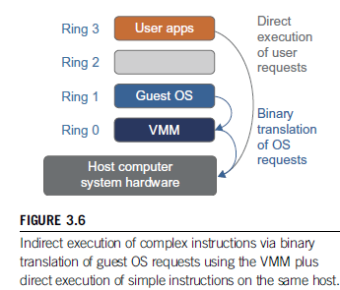
Binary Translation of Guest OS Request using VMM

Slide 86
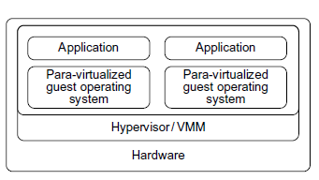
Para-Virtualization
The guest OS are modified by the Para-Virtualization
Special API is provided by the para-virtualized VM which requires substantial OS modification in the user application
Following fig. illustrate the concept of para-virtualized VM architecture

Slide 87
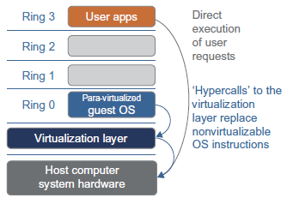
In the traditional x86 processor, there are four instruction execution rings: Ring 0,1,2,3
The lower the ring number, higher the privilege of instruction being executed
The hardware management and execution of privileged instruction is done by the OS so implemented at Ring 0, while user-level application are executed at Ring 3

Slide 88
Types of Hypervisor
A hypervisor is a hardware virtualization technique allowing multiple operating systems, called guests to run on a host machine. This is also called the Virtual Machine Monitor (VMM).
Type 1: Bare Metal Hypervisor
sits on the bare metal computer hardware like the CPU, memory, etc.
All guest operating systems are a layer above the hypervisor.
The original CP/CMS hypervisor developed by IBM was of this kind.
Type 2: hosted hypervisor
Run over a host operating system.
Hypervisor is the second layer over the hardware.
Guest operating systems run a layer over the hypervisor.
The OS is usually unaware of the virtualization

Slide 89
Thank YOU!

